Slide 1
Key challenges in rural surgical education
Dr Andrew Evans

Slide 2
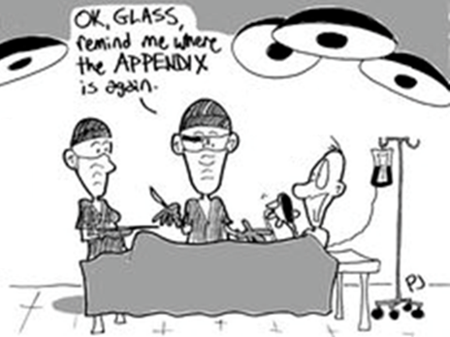
What we’re going to cover
General challenges
Rural-specific challenges
A model

Slide 3
The Evans Exposure Equation
Simulation
+
Prioritisation
=
Exposure

Slide 4
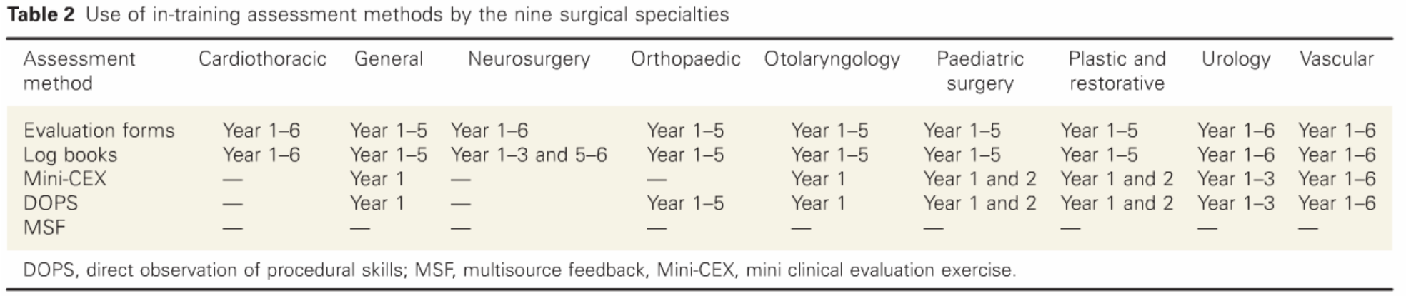
Competency based curriculum… A Problem of Assessment
Good assessment tools | RACS workplace assessment tools | Challenges to implementation
Valid Reliable Acceptable | Evaluation forms Logbook Mini CEX Direct observation of procedural skills Multi-source feedback | Burden of assessment Lack of resources or training Separating formative from summative Pre-occupation with assessment

Slide 5
Rurally-Oriented Surgical Education Needs…
…a strong focus on Generalism
…predominantly rural training

Slide 6
Rurally-Oriented Surgical Education Needs…
…a strong focus on Generalism
…predominantly rural training

Slide 7
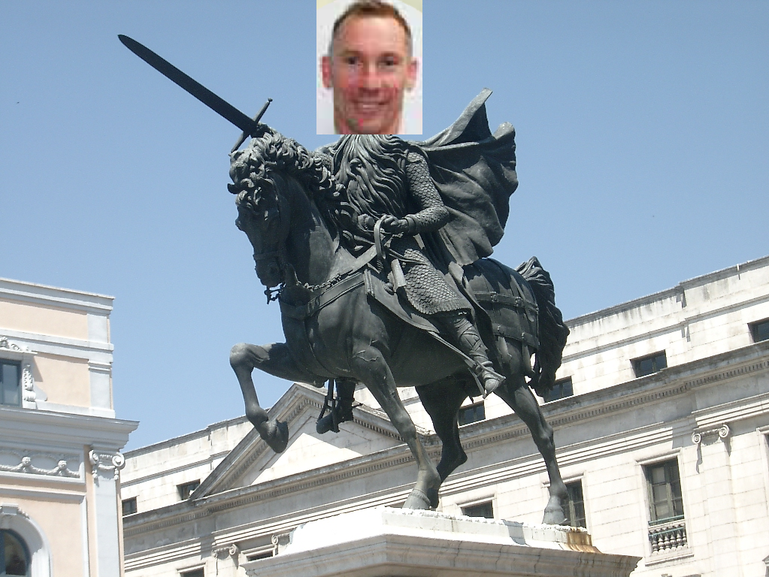
A solution
Rural training hubs

Slide 8




To Wrap UP
General challenges
  Exposure
    Simulation
    Prioritisation
  Competency based curriculum
    Assessment
Rural training hubs
Rural-specific challenges
  Strong focus on Generalism
    Balancing act
    Competency based curriculum and outcomes data
  Predominantly rural training
    For workforce retention: professional and personal reasons

